Slide 1
Vigenère Cipher

Slide 2
Introduction
This system is used to encrypt and decrypt English , Arabic plaintexts
And the system allow user to choose type of Vigenère he want from two types autokey and one time pad.
Autokey type of Vigenère which need to repeat the key as long as the message.
One time pad Use a random key that is as long as the message so that the key need not be repeated.

Slide 3
Background
Vigenère cipher, type of substitution cipher used for data encryption in which the original plaintext structure is partially hidden in the ciphertext by employing many monoalphabetic substitution ciphers rather than just one.

Slide 4
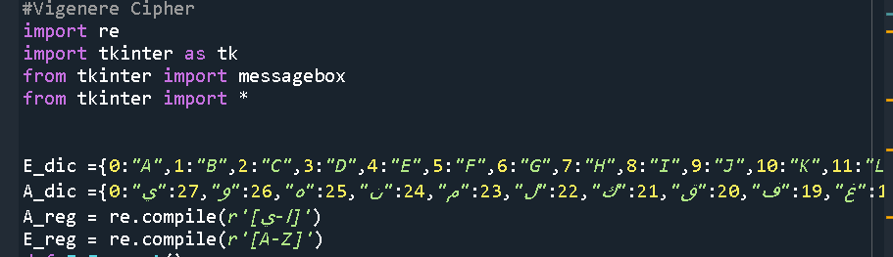
System Implementation
At first import some packages :
re; check if a particular string matches a given regular expression.
thinker; GUI library for Python “tk interface”,
“message box to display message boxes”
“* represents all the functions and built-in modules in the tkinker library”
Then identify letters of English & Arabic respectively with numbers.

Slide 5
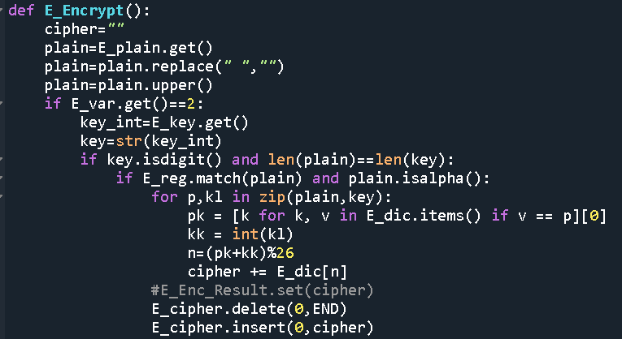
System Implementation
In this part we write a function to encrypt English P.T.
if value == 2 then you clicked on OTP
Also check if P.T match regular expression .
Look on key and P.T respectively.
Take each letter in p.t to see which number represent it.
Calculate C.T

Slide 6
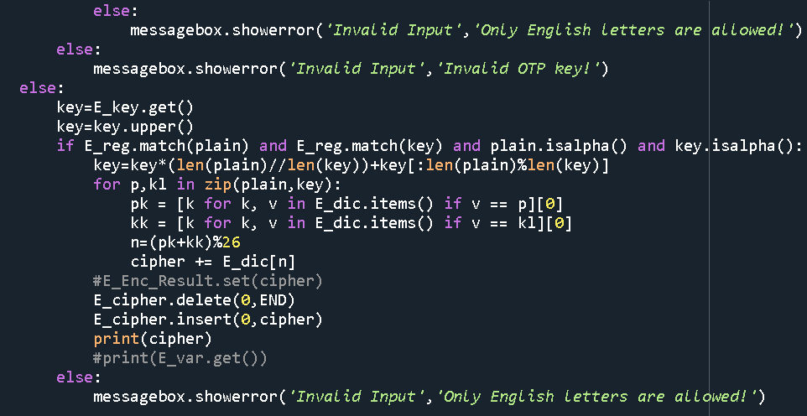
System Implementation
If E-var == 0 or 1 it will be auto key
As default choice is autokey.
Calculate how many time key will be repeated using integer division.
As key is not a number then take each letter to take its corresponding number.

Slide 7
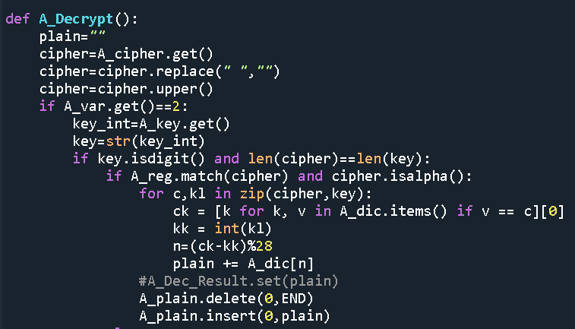
System Implementation
In this part we write a function to Decrypt Arabic P.T
Same steps as English decryption with some changes ;
Arabic key & Arabic P.T
Search in Arabic dictionary.

Slide 8
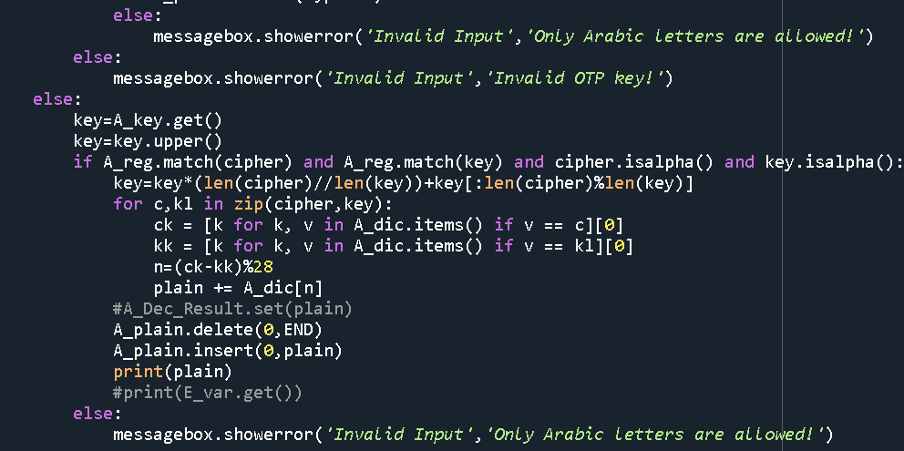
System Implementation
In this part only Arabic letters and numbers.
If E-var == 0 or 1 it will be auto key
As default choice is autokey.
Calculate how many time key will be repeated using integer division.
As key is not a number then take each Arabic letter to take its corresponding number.

Slide 9
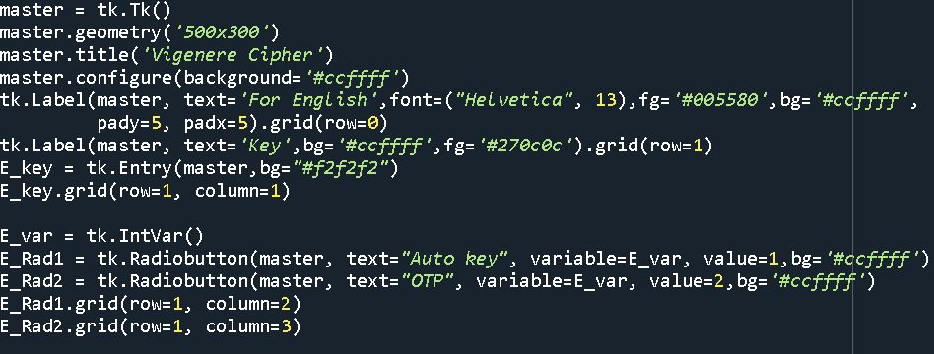
System Implementation
GUI part
Name system screen as master , give it size and title ,background color.
System screen will be designed like a table with rows and columns.
Make a label for English , English key , text field to enter key.
Make a radio button for Auto key & OTP and give each one a value.

Slide 10
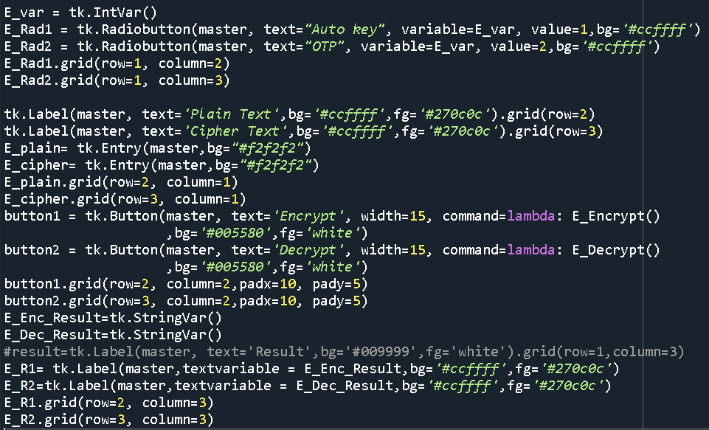
System Implementation
Make a label for plain text and cipher text & text field for both.
Make two buttons one to encrypt and other to decrypt.
Put each of them in their place in the table.

Slide 11
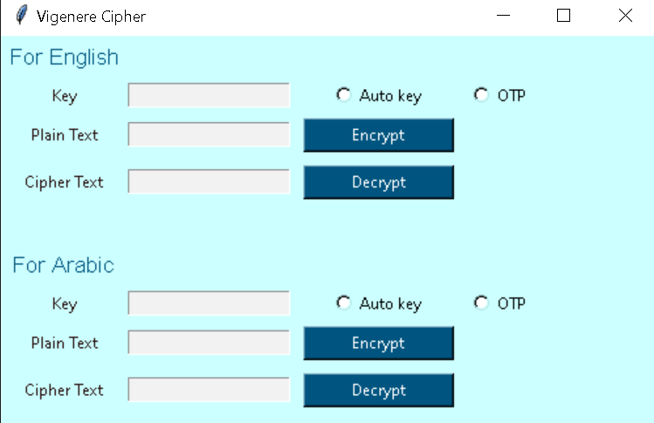
How the system work?
First you need to choose what type of Vigenère you want (Autokey , one time pad).
Second enter key and plain text (no numbers, no special characters).
Third choose to encrypt P.T ,
C.T will appear if you want to decrypt click on decrypt button

Slide 12
System testing

Slide 13
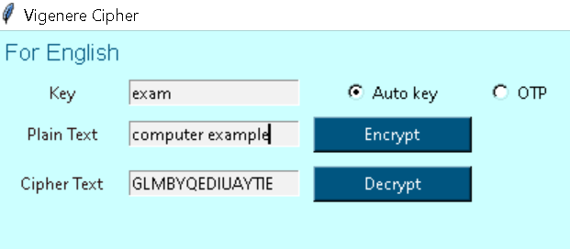
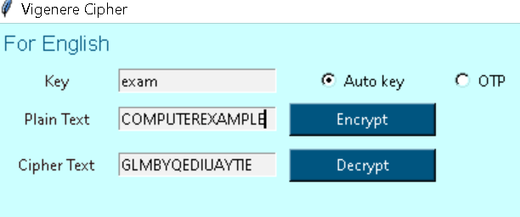
System testing
For English
First, we choose to use autokey
And encrypt P.T computer example using key exam then C.T appeared.
Second, we used C.T appeared in encryption to see if it evaluate the same P.T computer example.
Finally, it worked successfully.

Slide 14
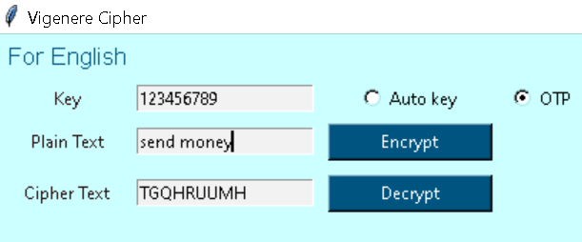
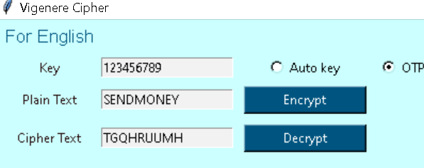
System testing
For English
First, we choose to use OTP
And encrypt P.T send money using key 123456789 then C.T appeared.
Second, we used C.T appeared in encryption to see if it evaluate the same P.T send money.
Finally, it worked successfully.

Slide 15
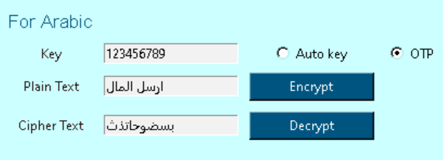
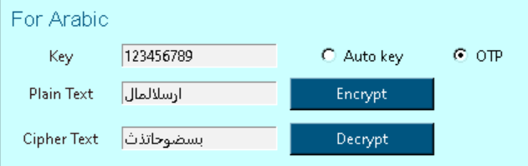
System testing
For Arabic
First, we choose to use OTP
And encrypt P.T ارسل المال using key 123456789 then C.T appeared.
Second, we used C.T appeared in encryption to see if it evaluate the same P.T ارسل المال
Finally, it worked successfully.

Slide 16
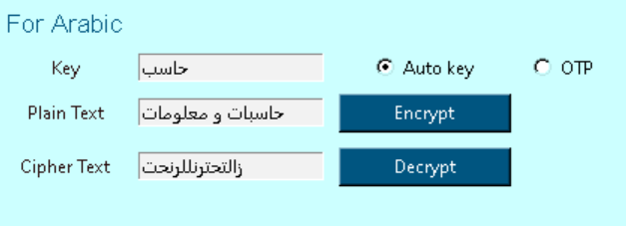
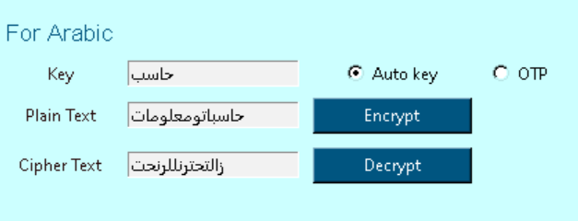
System testing
For Arabic
First, we choose to use auto key
And encrypt P.T حاسبات و معلوماتusing key حاسبthen C.T appeared.
Second, we used C.T appeared in encryption to see if it evaluate the same P.T حاسبات و معلومات
Finally, it worked successfully.

